Slide 1
The Organization & Financing of Terrorism
Chapter 3

Slide 2
Overview
Organizations always need to change and adapt
Two factors can change:
  Structure
  Finances
What are their motivations?
  Terrorizing an entire population OR
  Selective tactic?
To investigate terrorism, one must know the above

Slide 3
Models of Terrorism
Modern terrorism (post-1945)
Largely consisted of colonial rebellion
3 models:
  Rural
  Urban
  Insurrection

Slide 4
Guerrilla Warfare and Rural Terrorism
Mao toppled the Chinese Government (1949)
Cuban Revolution led by Castro and Guevara (1956-59)
Guerrilla war:
  preferred tactic of left-wing revolutionaries in Latin America
Cuban Revolution
  Ousted Dictator Batista in 1959
  Cuban Guerilla War tactic (3-step process):
  Revolutionaries join indigenous population
  Small forces form columns and control rural areas
  Columns unite to overthrow government

Slide 5
Cont…
Terrorism played limited role
Where it was used, it was used selectively by urban terrorists
  Terrorizing the government in their “safe areas”
  (1) To demoralize them and (2) to strike their logistical networks
Why Latin America created so many left-wing revolutionaries?
Debray argues it’s poverty
  Revolution is the only way to change the system

Slide 6
Urban Terrorism
Frantz Fanon (1925-1961)
Overthrow colonial powers
  They have dehumanized non-Western people by imposing their values onto them
Violent revolt only answer
Guerrilla warfare is the only way to fight national government
  Terrorism should be used selectively
  Target white settlers and middle class in Algeria
  You don’t want to alienate natives (potential supporters)
  Governmental repression is a good thing

Slide 7
Marighella & the Urban Model
Carlos Marighella – communist legislator turned terrorist in Brasil
Author of popular handbooks on how to wage urban terrorism
Spontaneous violence could lead to revolution
  Uncoordinated activities
  Targets with symbolic value
  Psychological assault
In the end though, his strategy DOES NOT WORK.

Slide 8
3rd Model - Insurgency
Lessons from Vietnam
David Petraeus
  A counter-insurgency doctrine
  A bit of a paradox
  Soldiers must refrain from shooting and employ community policing
Applied in Iraq with mixed reviews
How is terrorism used in the rural guerrilla model?

Slide 9
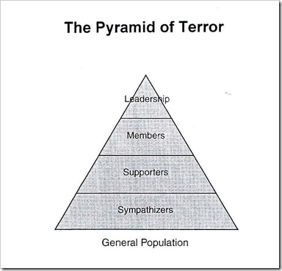
Structures of Organizations
Terrorists organize like any other group, only they have to do in secret
The evolution of CELLS
  Started with the IRA in Ireland.
  Each cell had its own mission; did not know other cells
Pyramid scheme (traditional)
  Most common job in terrorist group is support!
  Hierarchy
  Most groups number less than 50 people!

Slide 10
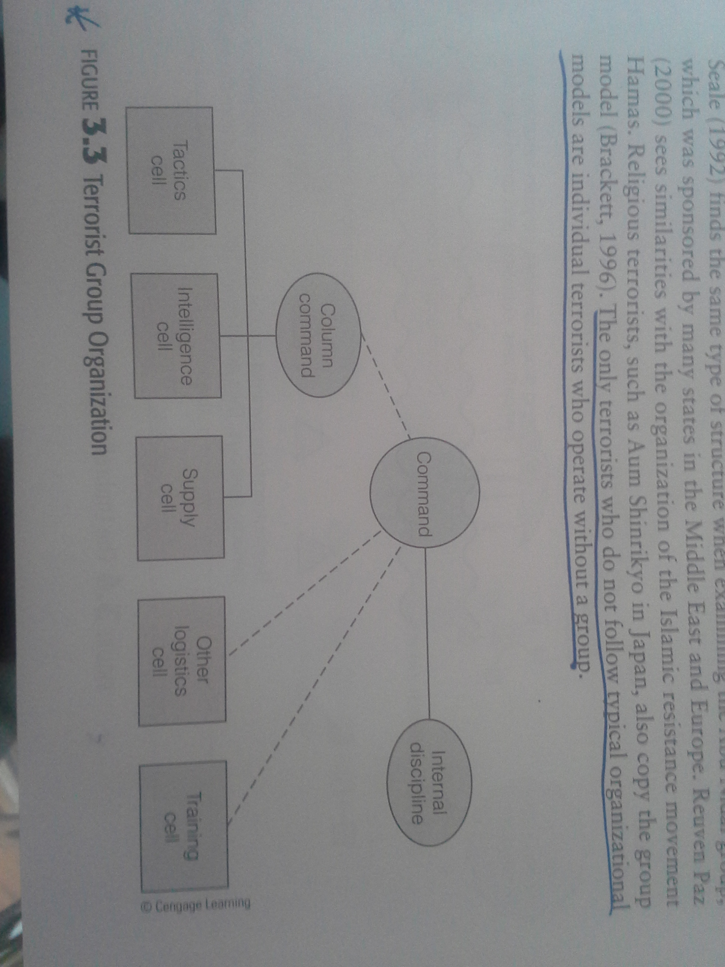
Sub-units and Cells
The cell and the column
Only terrorists who do not follow organizational model are lone-wolves

Slide 11
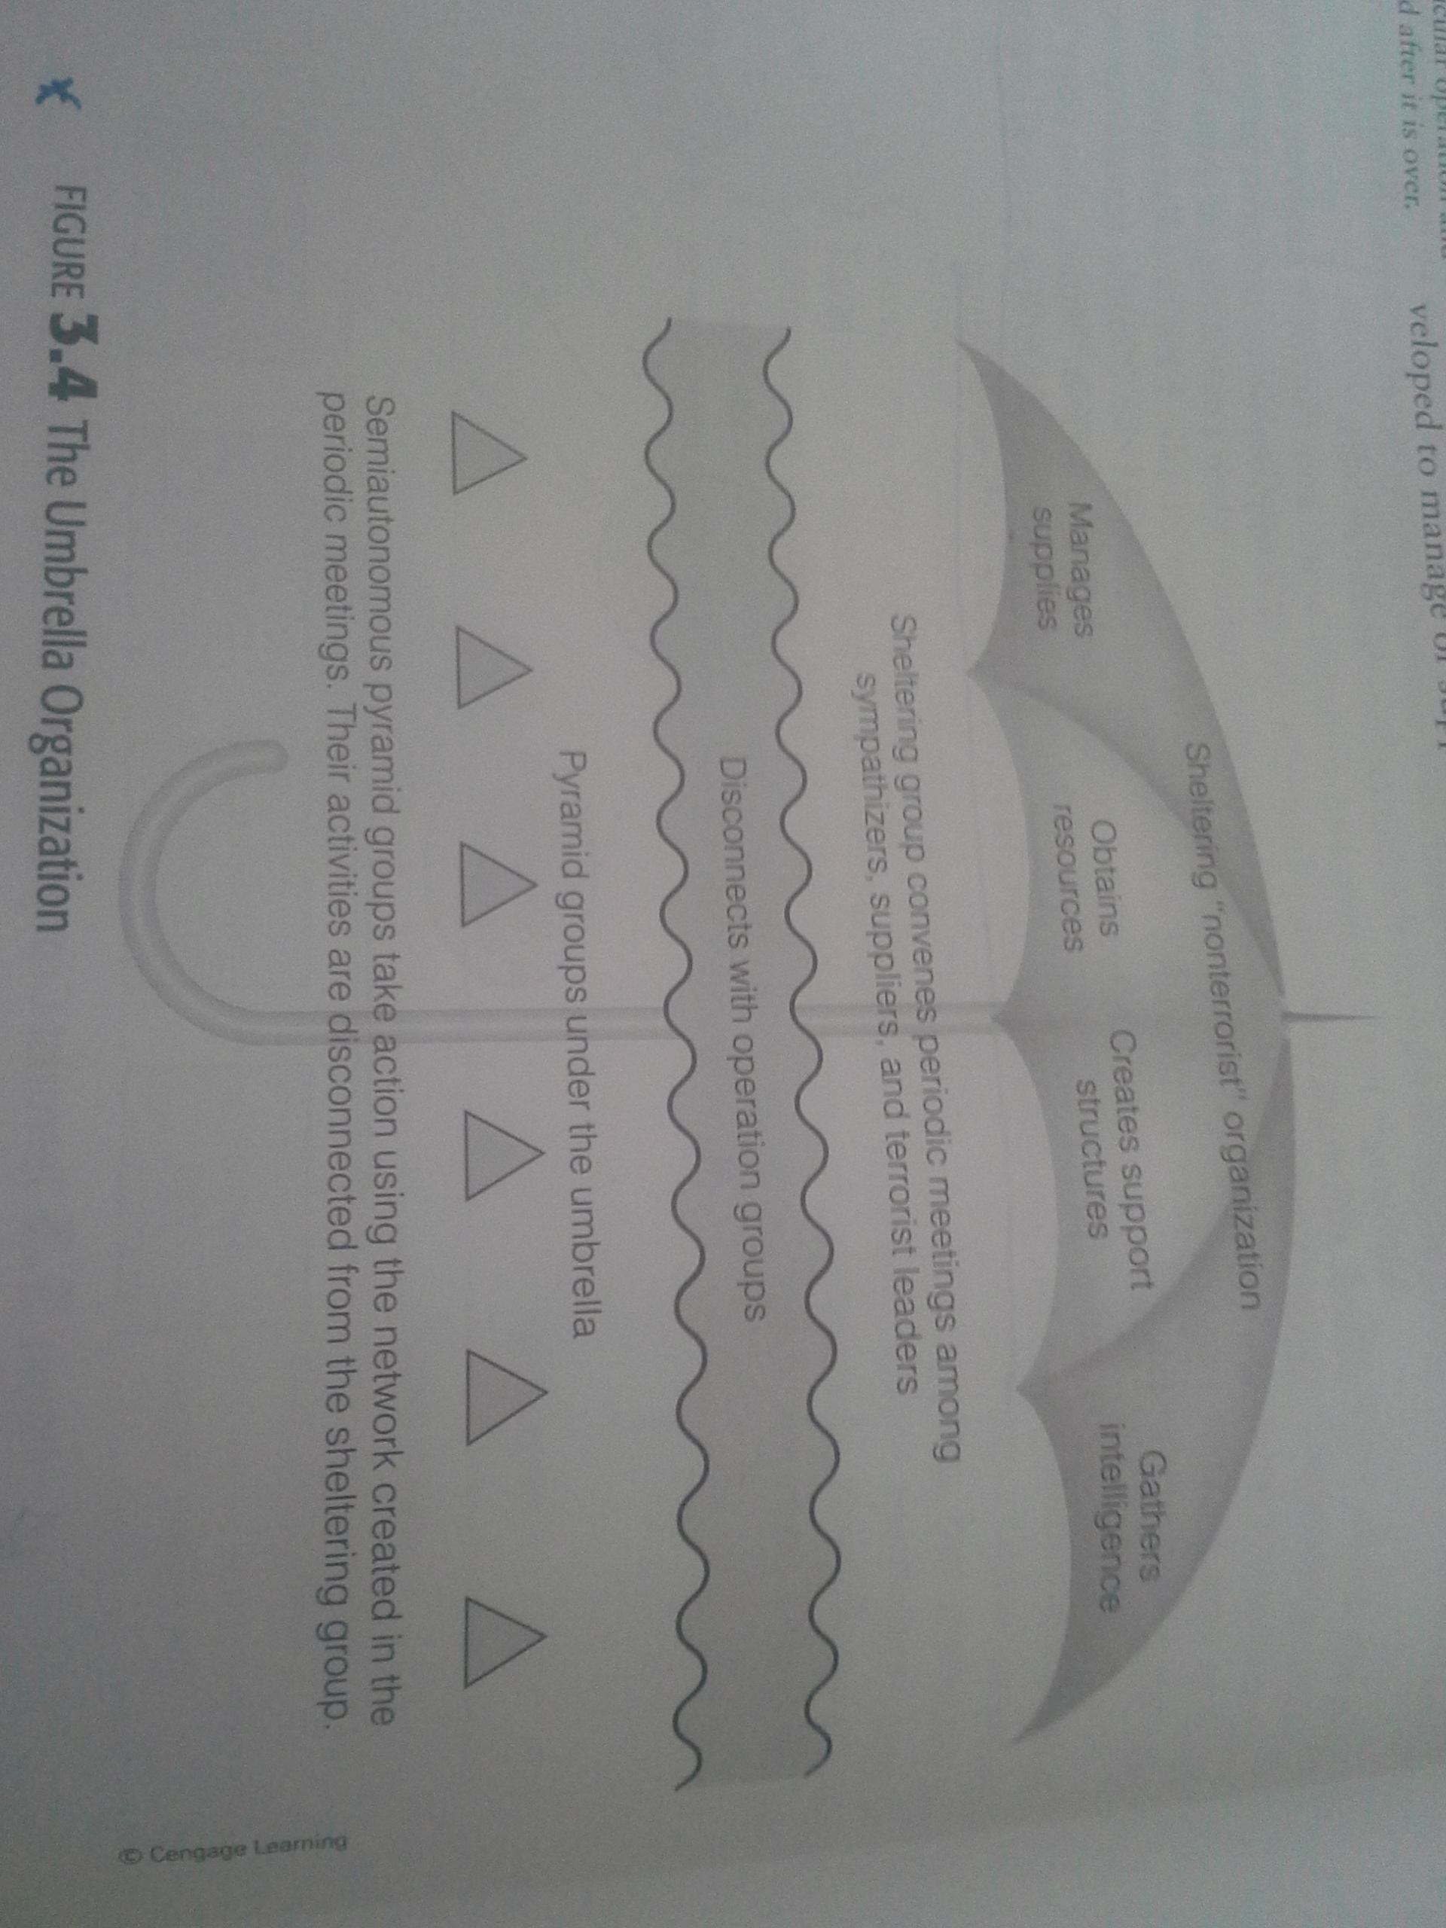
Umbrella Organization
Early 1980s, new models emerged
Umbrellas or Hubs
Terrorist Network
  Ability to communicate via internet
  Swarming ability

Slide 12
Modern Piracy
Technologically advanced pirate
  GPS, satellite phones, rockets, grenades, machine guns
Umbrella organization
Somalia context and the Horn of Africa
Rise and fall of pirate incidents
  Key to fall – Prevention
Compare and contrast each organizational structure (i.e. pyramid, umbrella, hub, virtual organization).

Slide 13
Managing terrorist organizations
Problem 1 – maintaining secrecy
Problem 2 – prevent splintering of organization
Command structures are popular in areas where government is absent
  E.g. Tribal areas of Pakistan
  Led to multiple terror or attempted attacks in West

Slide 14
Financing Modern Terrorism
Financing a single event vs. a campaign
Does following the money work the same with terrorists?
  Yes and no
  Terrorists are different than traditional organized crime
  E.g. the frequency of laundering money
Terrorist are in the legal and underground economies
Forensic accounting as “one” tool to develop large picture

Slide 15
Illegal funding methods
Central Asia terrorist groups have:
  Used document fraud, trade illegal arms, distribute drugs, launder money
Latin America has used:
  Drug cultivation and public corruption to fuel their cause
Hezbollah has been tied to cigarette smuggling in US along with baby formula theft
  Afghan Taliban and IRA has also been tied to cig smuggling/fake production
Retention car thieves and re-sell in other countries (SUVs)

Slide 16
Legal Methods
Network and systems
  Networks cannot be built overnight, they depend on trust and long term rel.
  Can use existing networks that organized crime already uses
Link to organized crime
  Russian groups trade weapons for drugs (Colombia terrorists)
  Tri-border region of South America
    Paraguay/Brasil/Argentina – magnet for illegal activity
    Miami Vice filmed here
Laundering
  Black Market exchange (Colombia)
  Hawala System

Slide 17
Ex. Hezbollah
State sponsored organization
Iran funds them $200 million/year
  Also receives private donations from Lebanese people all over world
  Protection racket (like American Mafia) or Hezbollah tax

Slide 18
Failed States and crime
ETA in Basque Region of Spain

Slide 19
Narco-terrorism
Very controversial
  Either drug profits finance terrorism OR
  Gangs use terrorism to control production/distribution of drugs
The Mexico situation
  From Colombia to Mexico
  Kidnappings, murders and bombings
Others have argued there is no such link
  If terrorism disappeared from these regions, drug trade would still exist!
  Deliberate overstatement to get more funding to combat drug cartels
Essay Q1 – If Mexico becomes a failed state, what implications might this have on the future of terrorism in the rest of North America?

